Slide 1


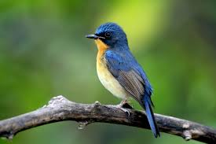
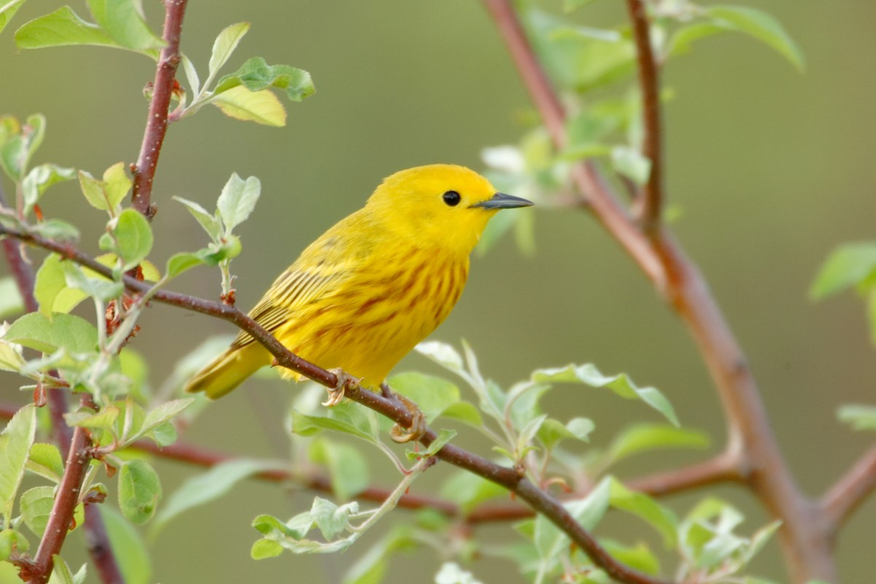
AI Mini Project
Bird Species Detection
System
Faculty: Dr. Vaishnavi Moorthy
RA1911032010011 Pratishtha Arya
RA1911032010030 Sailashree Pandab

Slide 2
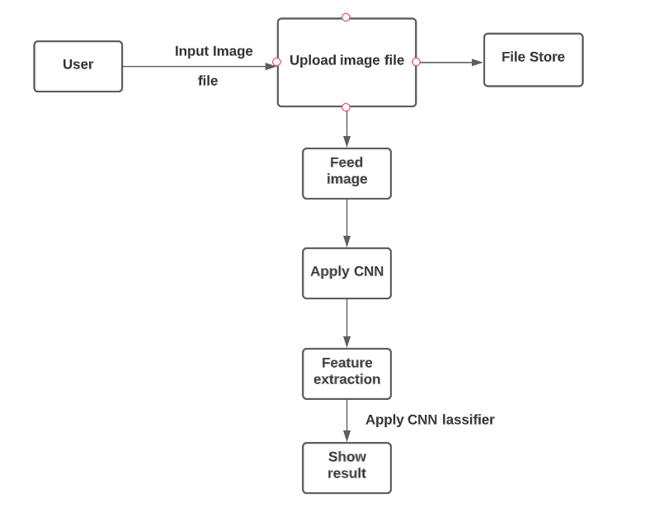
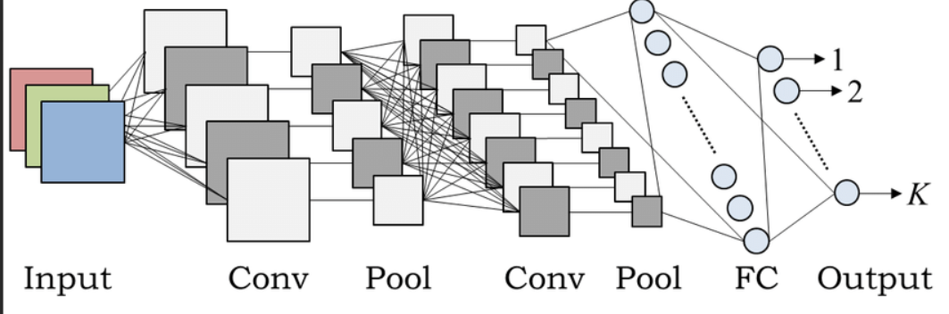
Problem statement:
Identifying a bird can be a challenge, even for experienced birders. And if you're new to using field guides, it can be daunting to figure out where to even begin searching in the hundreds of pages of species. By some features like size, shape and colour birds can be classified. By using CNN, we can classify the species of the birds.
Implementation:
Technique:
In wildlife research and monitoring, this concept can be implemented in-camera
traps to maintain the record of wildlife movement in specific habitat and behaviour of any species.
A solid framework that will give enormous scale preparation of data about birds and will fill in as a significant apparatus for scientists, legislative offices, and so forth is required.
The main idea behind developing the identification website is to build awareness regarding bird-watching, birds and their identification, especially birds found in India.
It also caters to the need of simplifying the bird identification process and thus making bird-watching easier.
Helps in Taxonomy
Convolution neural network algorithm is a multilayer perceptron that is the special design for the identification of two-dimensional image information.
It has four layers: an input layer, a convolution layer, a sample layer, and an output layer.
In a deep network architecture, the convolution layer and sample layer may have multiple.
FIG : Process Diagram and architecture diagram

Slide 3
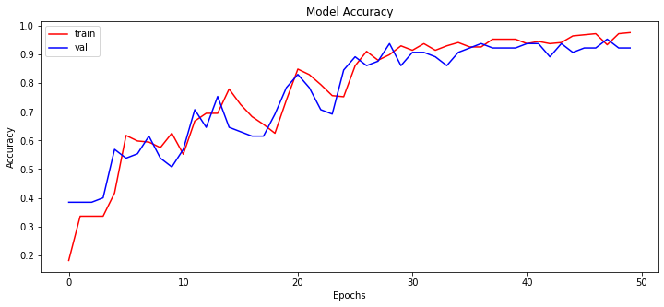
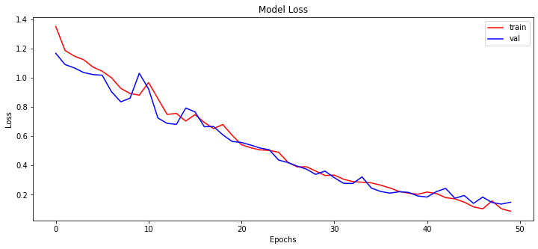
Feature extraction:
The selected features are expected to contain the relevant information from the input data, so that the desired task can be performed by using this reduced representation instead of the complete initial data.
Features:
Future enhancements:
In future, we can build an IOS/Android app which is user friendly.
It will help us detect dangerous birds.
It so happens that the extinct birds have been found and are left unrecognized. This app will help us identify their species.
Inference:
The main idea behind developing the identification website is to build awareness regarding bird-watching, birds and their identification, especially birds found in India.
It also caters to the need of simplifying the bird identification process and thus making bird-watching easier.
The technology used in the experimental setup is Convolutional Neural Networks (CNN).
It uses feature extraction for image recognition. The method used is good enough to extract features and classify images.
Dataset info:
Open source dataset
We have used 4 classes of bird species for our project including American Goldfinch having 143 images as dataset, carmine bee eater having 131 images, barn owl having 129 images and downy woodpecker having 3 images.
dtype: int64

Slide 4
THANKYOU

